Slide 1

Real-Time Weather App
Responsive Frontend App using HTML, CSS Grid, JavaScript & OpenWeatherMap API
  Presented By: Krishna Rajeshbhai Khokhariya
  Domain: Frontend Development

Slide 2
Introduction
The Real-Time Weather App is a fully responsive frontend web application that allows users to search for any city and view:
  Current weather conditions
  5-day forecast
  Location-based weather (auto-detection)
  Temperature unit toggle (°C / °F)
The app interacts with the OpenWeatherMap API and displays clean, dynamic UI updates including icons and background changes based on weather conditions.

Slide 3

Objective
To build a modern, responsive weather application using HTML, CSS, and JavaScript.
Provide real-time weather reports based on user search or location.
Display an interactive 5-day forecast with clean visual layout.
Ensure mobile-first responsiveness with CSS Grid + Flexbox.
Offer temperature unit conversion and dynamic background effects.

Slide 4

Problem Statement
Users need a simple and reliable way to:
  Check real-time weather conditions across any location
  View upcoming forecasts
  Access weather information in a visually clear, responsive design
  Quickly switch between Celsius and Fahrenheit
Goal: Build a weather app that is accurate, fast, responsive, and user-friendly.

Slide 5

Techniques Used
HTML5 structured layout (semantic sections)
CSS3 Grid System for page structure
CSS Flexbox for organizing UI components
Media Queries for responsiveness across all screen sizes
Dynamic DOM Manipulation using JavaScript
Fetch API for real-time REST API calls
API Integration (Weather + Forecast)
Conditional Rendering (valid city, invalid city, network error)

Slide 6

Tools Used
VS Code – Code editor
Chrome DevTools – Debugging & responsive testing
Git & GitHub – Version control & deployment
OpenWeatherMap API – Weather + Forecast data
JavaScript (Vanilla) – Logic, events, UI updates
CSS Grid + Flexbox – Responsive design

Slide 7

Development Workflow
UI layout planning (search box, toggle, cards, forecast)
Add loading animation (preloader)
Create responsive layout using CSS Grid
Add search bar + toggle button
Build mobile-first structure + media queries
Write JS to fetch:
  Current weather
  5-day forecast
Implement error handling (404 city, network issues)
Add background gradients based on weather type
Implement Geolocation API for default weather
Extract midday forecast entries
Inject dynamic HTML into UI
Polish layout and test on multiple screen sizes
Push project to GitHub

Slide 8

User Workflow
User opens the application
App requests location → loads current weather
User types a city name
User clicks search button or presses Enter
App displays:
  Temperature
  Weather icon
  Humidity
  Wind speed
  Feels-like
Below that → 5-day forecast appears
User toggles °C ↔ °F → All values instantly update
Background changes depending on weather conditions
If city is invalid → error message shown
On mobile → layout auto-adjusts to stacked format

Slide 9
Architecture Overview
Frontend Only (No Backend)
HTML for structure
CSS Grid for responsive layout
JavaScript for:
  API calls
  DOM updates
  Event listeners
  Geolocation handling
External API:
OpenWeatherMap → JSON Data → Rendered on UI

Slide 10

UI & Responsiveness
Grid layout changes based on screen size:
  Mobile (<600px): stacked layout, forecast in rows
  Tablet (600–992px): two-column weather layout
  Desktop (>992px): full grid, 5-column forecast
Preloader animation for smooth loading
Dynamic background for weather types

Slide 11
Key Features Demonstrated
✔ Live Weather Updates
✔ Geolocation-based weather
✔ 5-Day Weather Forecast
✔ °C ↔ °F toggle
✔ Error Handling
✔ Fully Responsive UI
✔ Dynamic Weather Backgrounds
✔ Clean & Modern Grid Layout

Slide 12

Results
Fully functional, user-friendly weather application
Works on all devices (mobile, tablet, laptop, large screens)
Smooth and fast API integration
Clean UI with dynamic effects
Accurate weather and forecast information

Slide 13
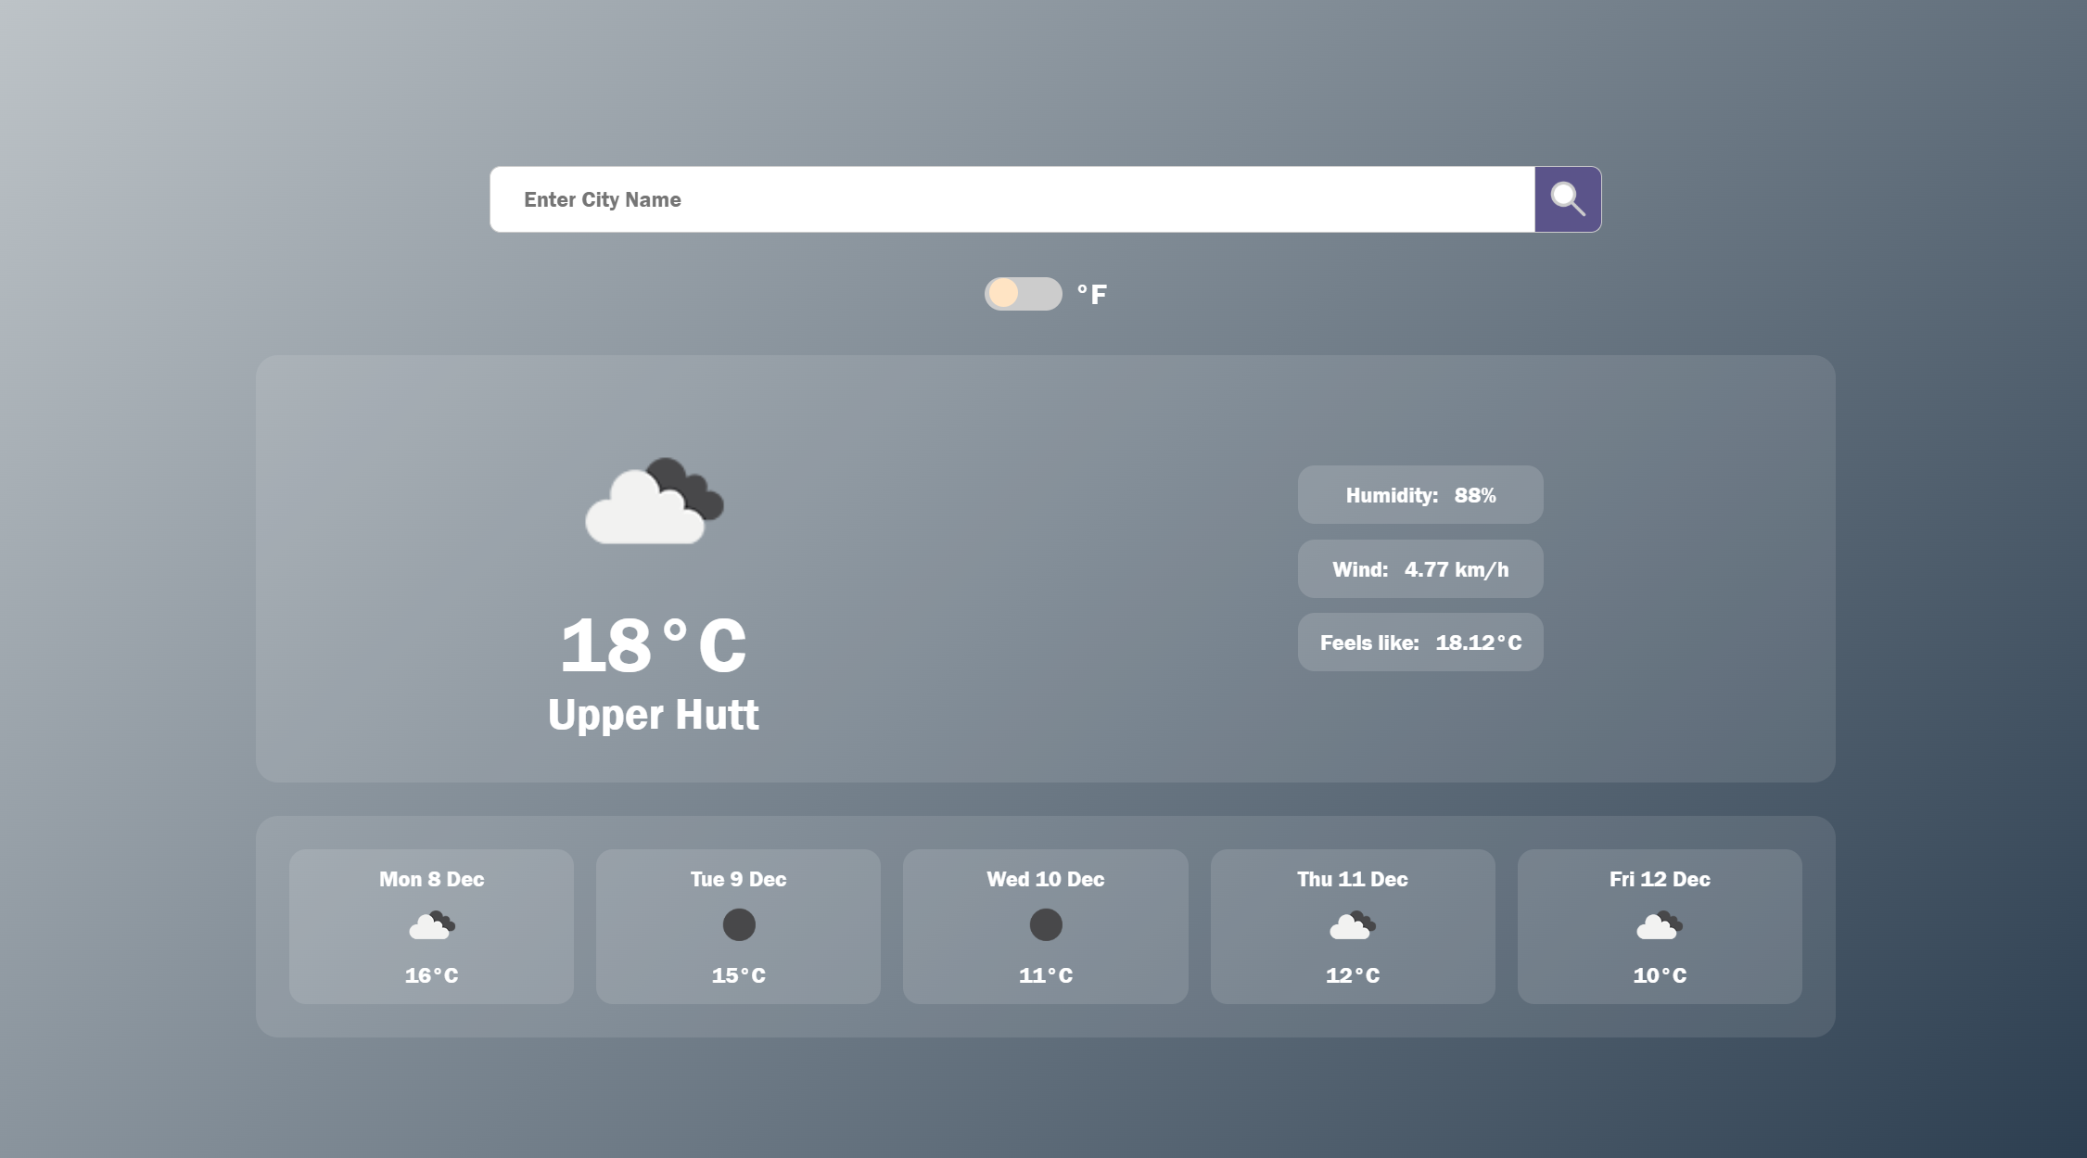

Slide 14

Conclusion
The Real-Time Weather App successfully demonstrates:
  API integration
  Modern responsive UI design
  JavaScript-based dynamic rendering
  Grid and Flexbox layout techniques
  Smooth user experience across devices
This project showcases core frontend development skills essential for real-world web applications.

